Slide 1

Exploratory Data Analysis
HEALTH CARE – DRUG PERSISTENCY
4TH OCTOBER 2021

Slide 2
Background
One of the challenge for all Pharmaceutical companies is to understand the persistency of drug as per the physician prescription.
To solve this problem, ABC pharma company is seeking to automate this process of identification.

Slide 3
Problem Statement
ABC pharma company has a challenge in understanding drug persistency as per physician prescription and to solve this problem it wants to automate the process of identification.
Objective is to build a classification model for drug persistency identification.
This will automate the process of identifying drug persistency for ABC pharma company thus helping the company to understand drug persistency as per physician prescription.

Slide 4
Data Analysis Approach
Explore and Understand the data.
Prepare and clean the data.
Analyze the data and find the features/variables that affects drug persistency.
Give recommendations for the classification model that is to be built to automate the process of drug persistency identification.

Slide 5
Data Exploration
One file used for the dataset
3,424 data points
75 features/variables (6 derived)

Slide 6
Analysis of Numerical Features

Slide 7
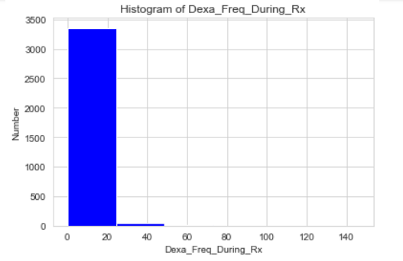
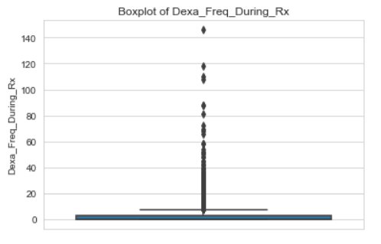
Dexa_Freq_During_Rx Analysis
This is the descriptive analysis of the dexa scan (bone density scan) frequency during the prescription.
From the diagrams above, we can see that most of the frequencies lie between 0 and 20.
The minimum frequency is 0 and the maximum is around 140.
The data is highly skewed.

Slide 8
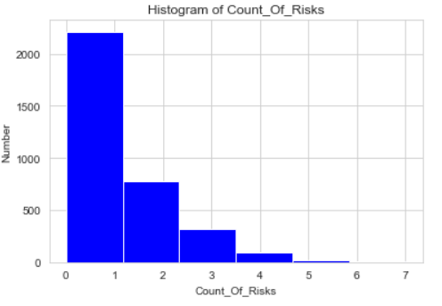
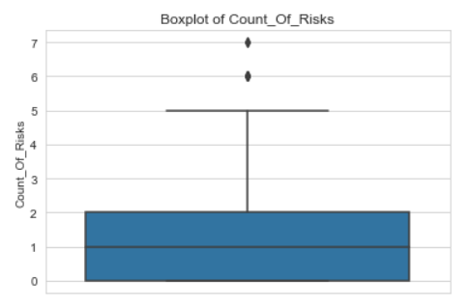
Count_Of_Risks Analysis
This is the descriptive analysis of count of risks for the patients.
Most of the count of risks lie between 0 and 1.
The minimum count of risks is 0 while the maximum is 7.
The data is slightly skewed.

Slide 9
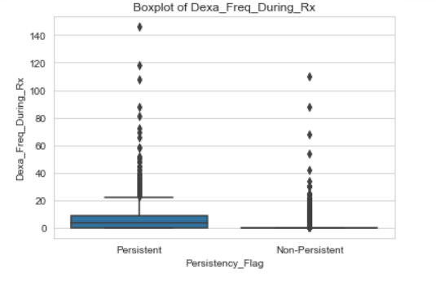
Dexa_Freq_During_Rx vs Persistency_Flag
There’s a huge difference in the distribution of the dexa scan frequency during prescription between persistent patient’s and non-persistent patients.
On average, those who are persistent have a higher dexa scan frequency during prescription as compared to those who are non-persistent.

Slide 10
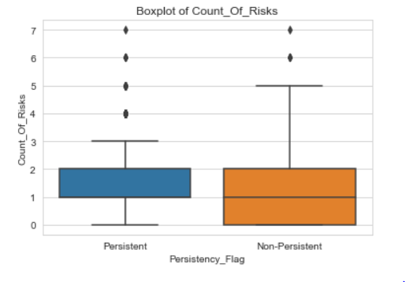
Count_Of_Risks VS Persistency_Flag
There’s a slight difference in the distribution of the count of risks between persistent patient’s and non-persistent patients.
50% of persistent patients have count of risks between 1 and 2, while 50% of non-persistent patients have count of risks between 0 and 2.

Slide 11

Numerical Features correlation with target feature
Dexa scan frequency has a higher correlation with persistency flag as compared to count of risks.

Slide 12
Analysis of Categorical Features
In this section we look at the categorical values of our analysis.

Slide 13
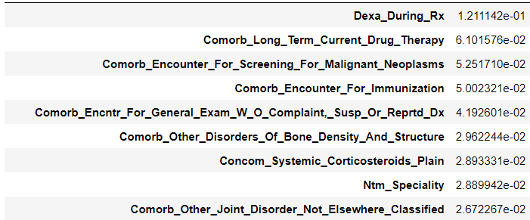
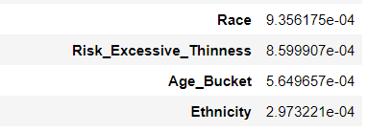
MUTUAL INFORMATION (MI) SCORE
Mutual information is the measurement of how much information one can obtain about a random variable given the value of another variable.
Table below shows the categorical variables with mi scores above 0.026
Table shows some categorical variables with mi scores below 1e-03

Slide 14
Class separation by categorical features
Using bar plots to visualize the separation of the target variable by the various categorical features.

Slide 15
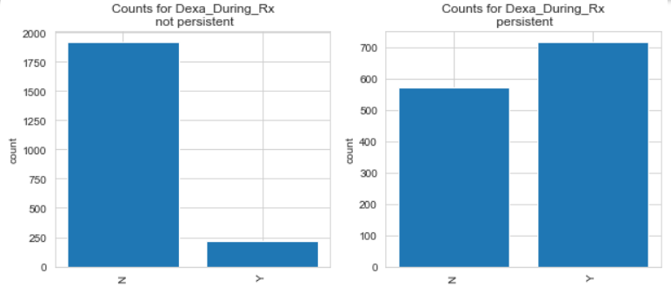
Class separation by Dexa_During_Rx
For the patients who are not persistent, the number of those who do not take dexa scan during prescription is way greater than those who take dexa scan during prescription.
As for patients who are persistent, those who take dexa scan during prescription are higher than those who don’t . Though the variation is not as big as for those who are not persistent.

Slide 16
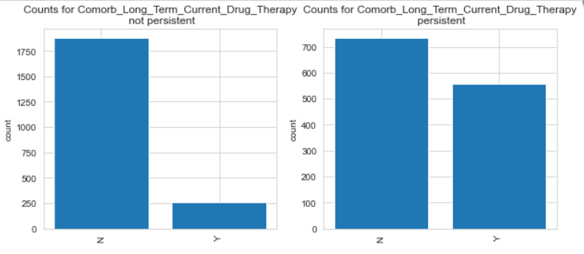
Class separation by Comorb_Long_Term_Current_Drug_Therapy
For persistent and non-persistent patients, the number of those who don’t have comorb_long_term_current_drug_therapy is higher than those who have.
For non-persistent patients, there is a big variation between those who have and those who doesn’t, while for the persistent patients, there is a slight variation.

Slide 17
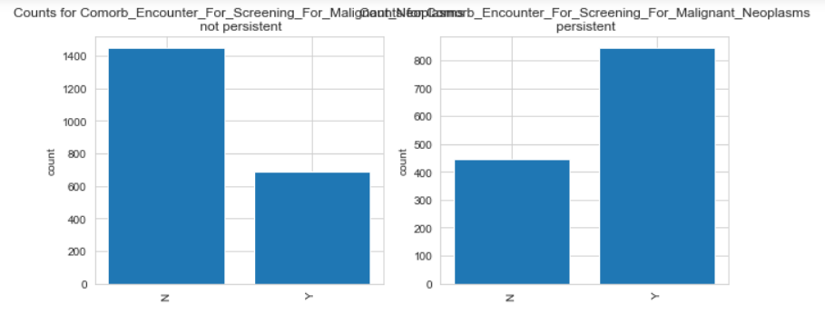
Class separation by Comorb_Encounter_For_Screening_For_Malignant_Neoplasms
For non-persistent patients ,those without Comorb_Encounter_For_Screening_For_Malignant_Neoplasms are higher than those with it.
As for persistent patients, those with Comorb_Encounter_For_Screening_For_Malignant_Neoplasms are higher than those without.

Slide 18
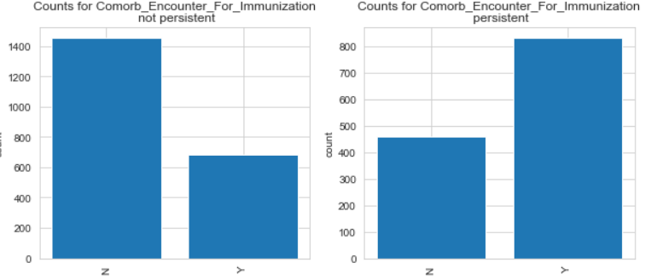
Class separation by Comorb_Encounter_For_Immunization
For non-persistent patients, those without Comorb_Encounter_For_Immunization are higher as compared to those with it.
As for persistent patients, those with Comorb_Encounter_For_Immunization are higher as compared to those without it.

Slide 19
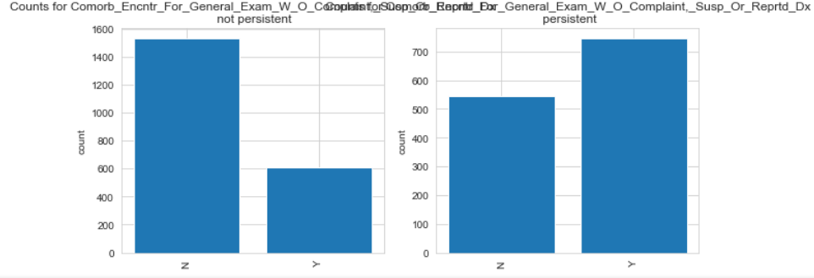
Class separation by Comorb_Encntr_For_General_Exam_W_O_Complaint,_Susp_Or_Reprtd_Dx
For non-persistent patients, those without Comorb_Encntr_For_General_Exam_W_O_Complaint,_Susp_Or_Reprtd_Dx are higher as compared to those with it.
As for persistent patients, those with Comorb_Encntr_For_General_Exam_W_O_Complaint,_Susp_Or_Reprtd_Dx are higher as compared to those without it.

Slide 20
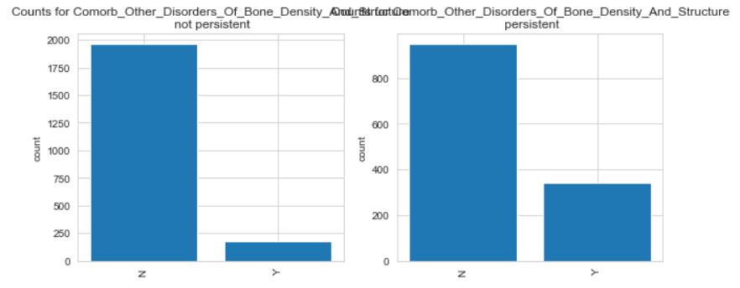
Class separation by Comorb_Other_Disorders_Of_Bone_Density_And_Structure
For both persistent and non-persistent patients, those with Comorb_Other_Disorders_Of_Bone_Density_And_Structure are higher as compared to those without.
There is a difference in variation for the persistent and non-persistent patients.

Slide 21
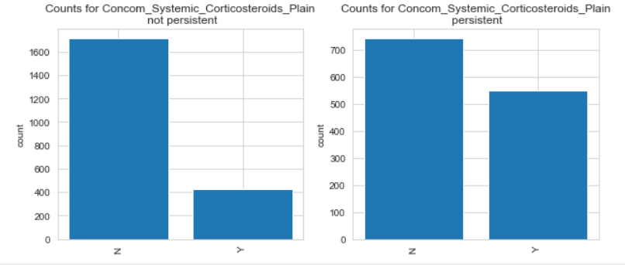
Class separation by Concom_Systemic_Corticosteroids_Plain
For both persistent and non-persistent patients, those without Concom_Systemic_Corticosteroids_Plain are higher than those with it.
There is a difference in this variation between the persistent and non-persistent patietnts.

Slide 22
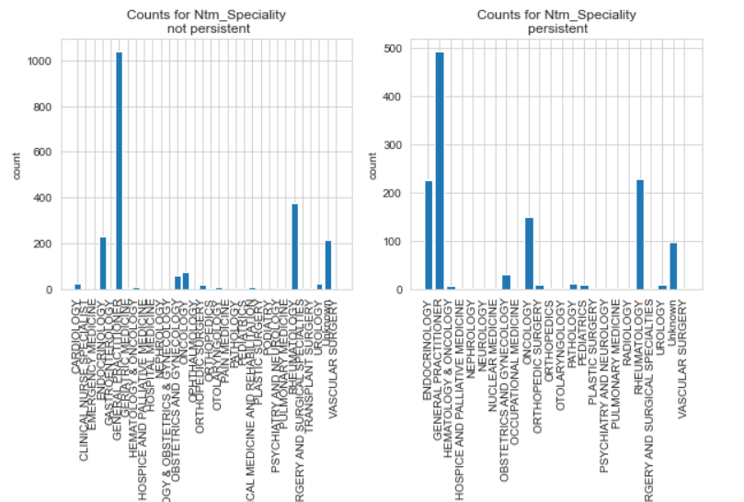
Class separation by Ntm_Speciality
There is variation in the number of patients in different Ntm speciality for the persistent and non-persistent.

Slide 23
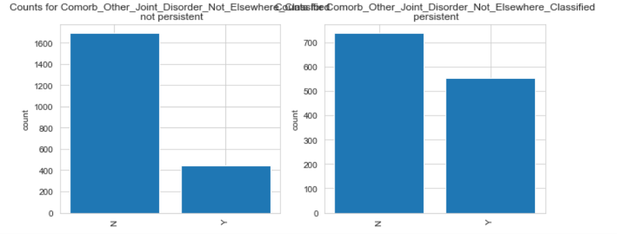
Class separation by Comorb_Other_Joint_Disorder_Not_Elsewhere_Classified
For both the persistent and non-persistent patients, those without Comorb_Other_Joint_Disorder_Not_Elsewhere_Classified are higher as compared to those with. This variation is high in the non-persistent patients, while is slight in the persistent patients.

Slide 24
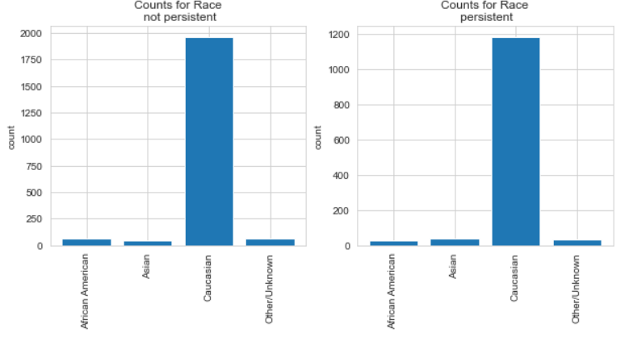
Class separation by Race
There is no difference in variation of patients in the different races for the persistent and non-persistent patients.

Slide 25
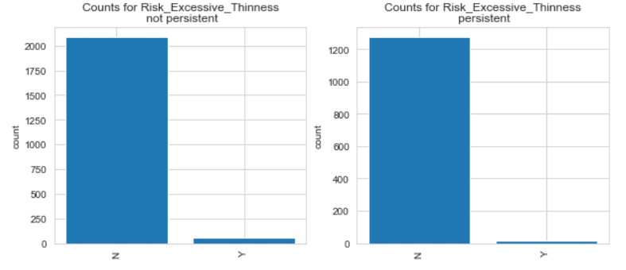
Class separation by Risk_Excessive_Thinness
The variation of those with Risk_Excessive_Thinness and those without are almost the same for the persistent and non-persistent patients.

Slide 26
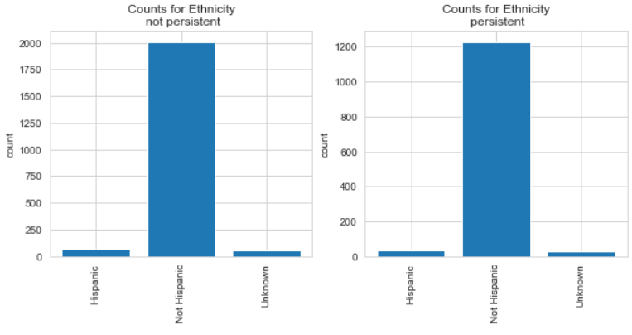
Class separation by Ethnicity
There is no difference in the variation of patients in the different ethnicities for both the persistent and non-persistent patients.

Slide 27
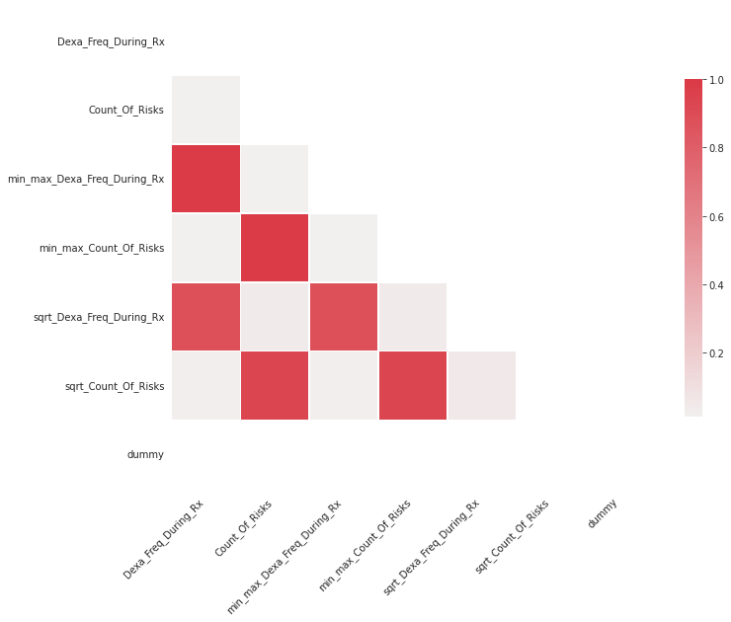
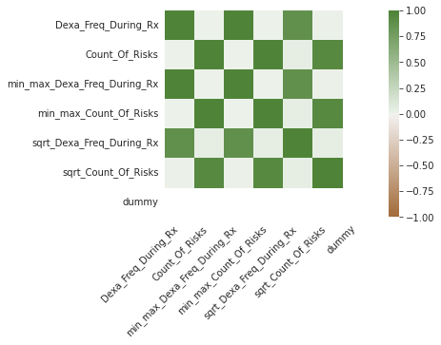
Correlations in the data

Slide 28
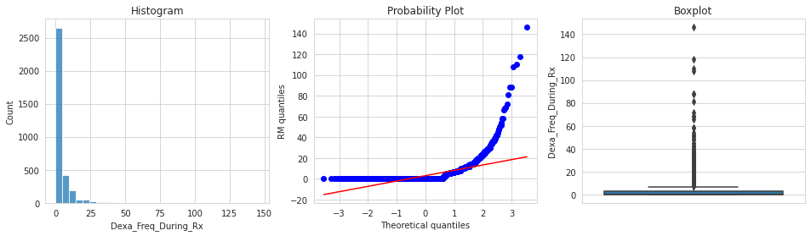
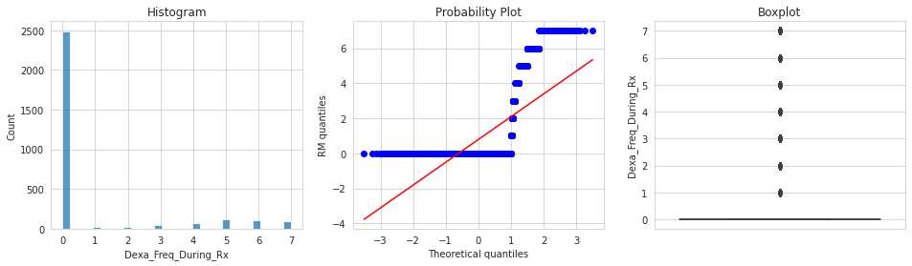
Removing outliers in the data

Slide 29
EDA Summary
From the Exploratory Data Analysis done, we are able to find how the different features/variables affects drug persistency.
The categorical variables that have higher MI scores have a greater effect in the drug persistency as compared to those that have low MI scores.
Dexa scan frequency during prescription correlates more with the target variable as compared to count of risks, thus it has effect on drug persistency as compared to count of risks.

Slide 30
Recommendations
For the purpose of automating the process of drug persistency identification, the following machine learning models can be used:
Logistic regression – It is a type of linear model that is used for binary classification. It predicts output which is a categorical dependent variable. Such predictions are like yes or no, A or B, etc.
LightGBM Classifier – This is high-performance gradient boosting framework based on decision tree that is used for classification.
Decision tree-They are good classifiers which are robust against outliers

Slide 31
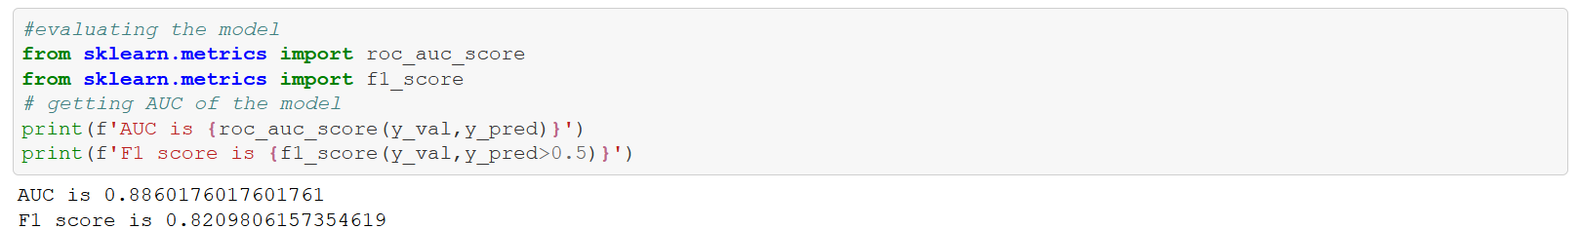
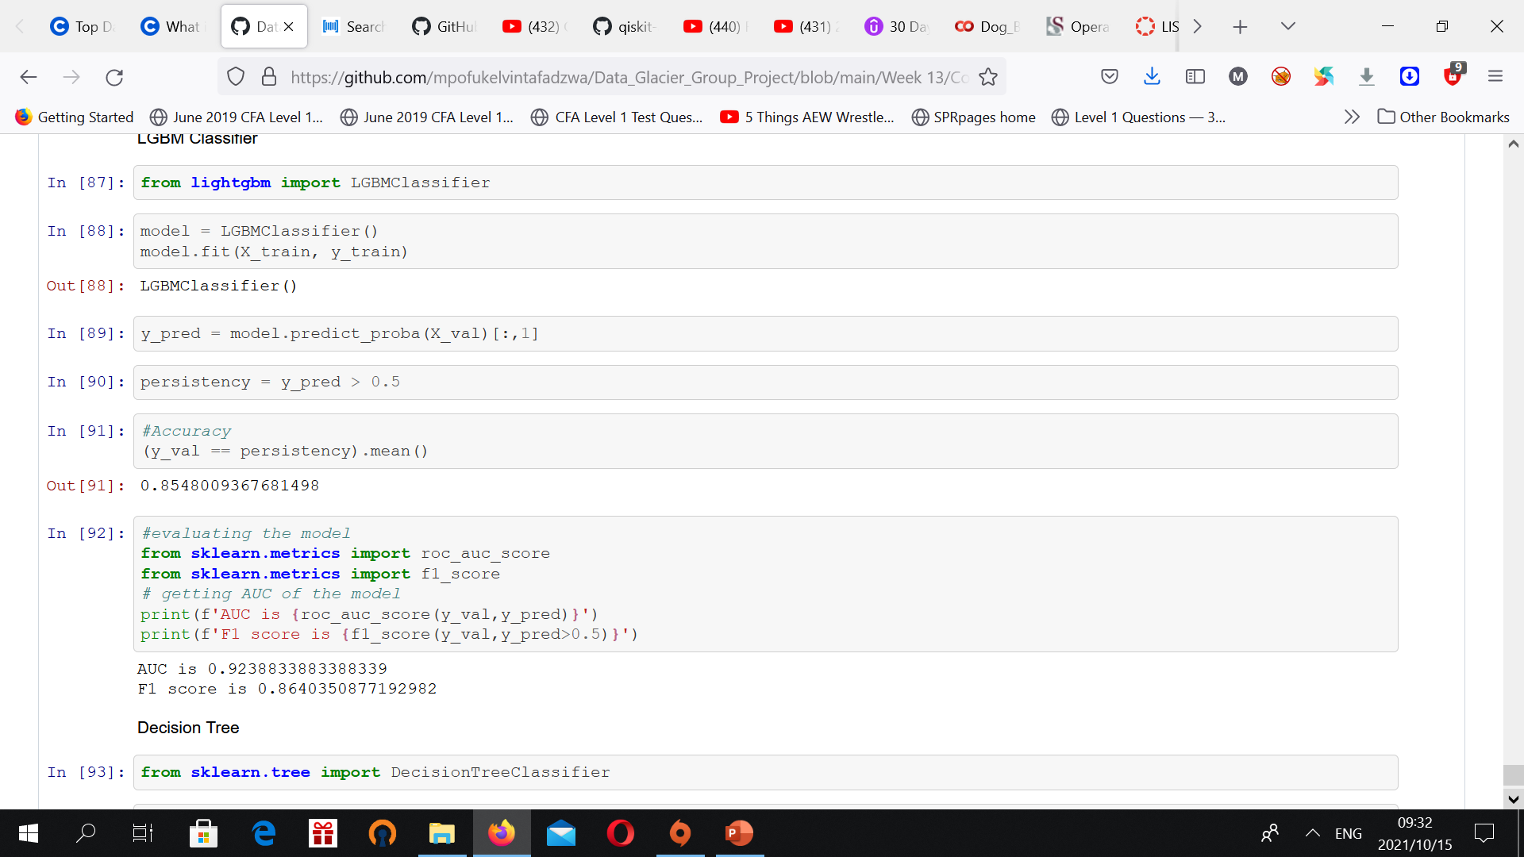
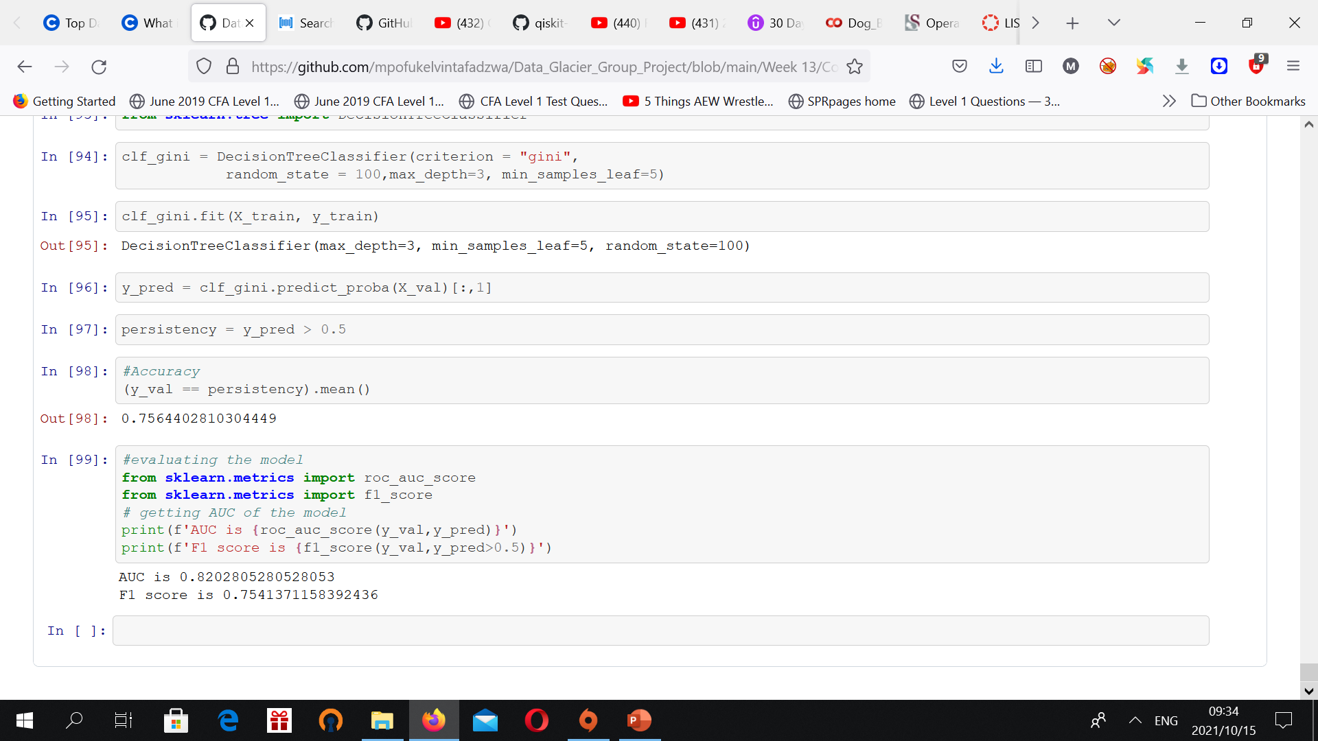
Logistic Regression
AUC and F1 scores for all algorithms
LGBM
Decision Tree

Slide 32
Best Algorithm
The LBGM algorithm gave us the better AUC AND f1 score values.

Slide 33

Thank You

